Slide 1

Lecture 3
-NLP is all about words, their arrangement and their meaning
-NLP is a branch of AI that tries to emulate/understand the way a human speaks to another human
-Lecture 3 is about punctuation and stopword removal (text pre-processing)

Slide 2
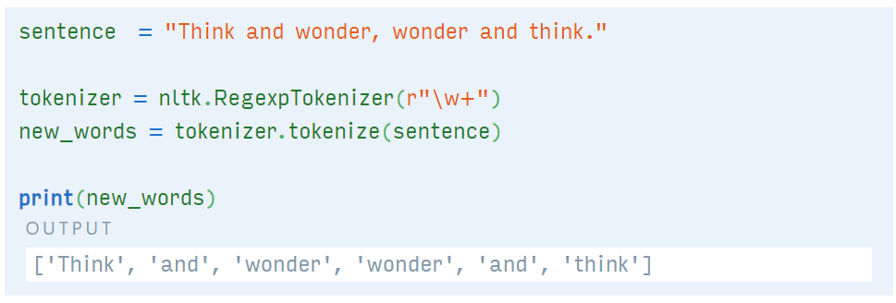
Identifying punctuations in input text
Use NLTK word_tokenize command (Lecture 2 slides)
OR
Use nltk.RegexpTokenizer(r”\w+”)
For eg.

Slide 3
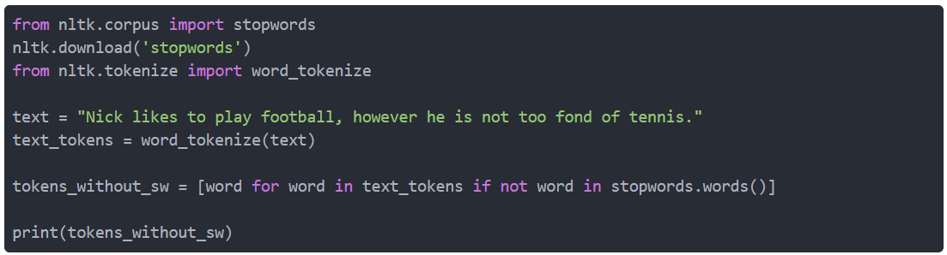
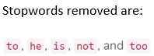
Stopword removal
Import the list of stopwords from nltk.corpus module
After tokenization, remove a word if it exists in the list of stopwords
Other than NLTK you also have SpaCy, Gensim, TextBlob libraries as alternatives (you can think of working on these for your NLP project)

Slide 4
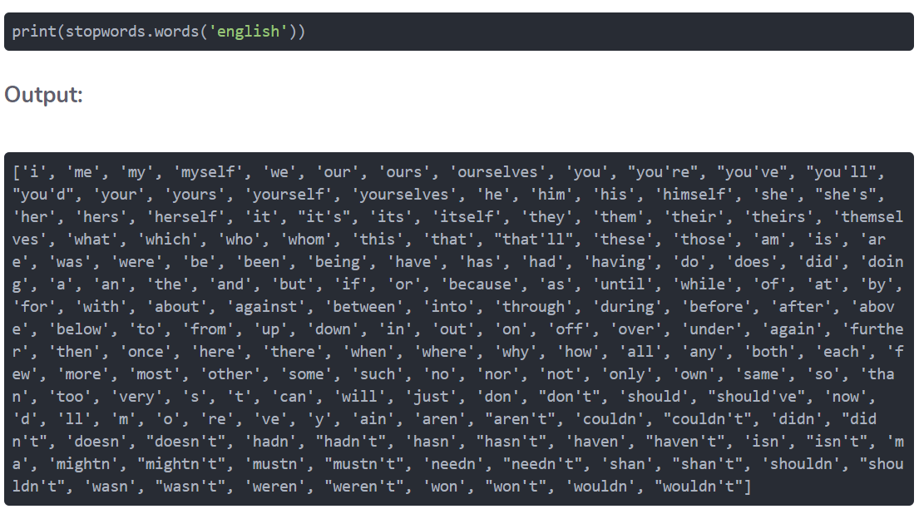
List of NLTK stopwords

Slide 5
Assignment 3
Remove the punctuation and stopwords from your Resume/CV (which was also the input text in Assignment 2). Submit a snapshot of the input and the output text, list the stopwords removed, and also add a discussion on how removing these stopwords has increased/decreased the chances of understanding the content of your CV for any NLP experiment.

